Slide 1
Colossians 1:15-20
(English Standard Version)

Slide 2
¹⁵ He is the image of the invisible God, the firstborn of all creation. ¹⁶ For by him all things were created, in heaven and on earth, visible and invisible, whether thrones or dominions or rulers or authorities — all things were created through him and for him. ¹⁷ And he is before all things, and in him all things hold together. ¹⁸ And he is the head of the body, the church. He is the beginning, the firstborn from the dead, that in everything he might be preeminent. ¹⁹ For in him all the fullness of God was pleased to dwell, ²⁰ and through him to reconcile to himself all things, whether on earth or in heaven, making peace by the blood of his cross.

Slide 3
The Supremacy / Preemininence / No.1-ness of Christ

Slide 4
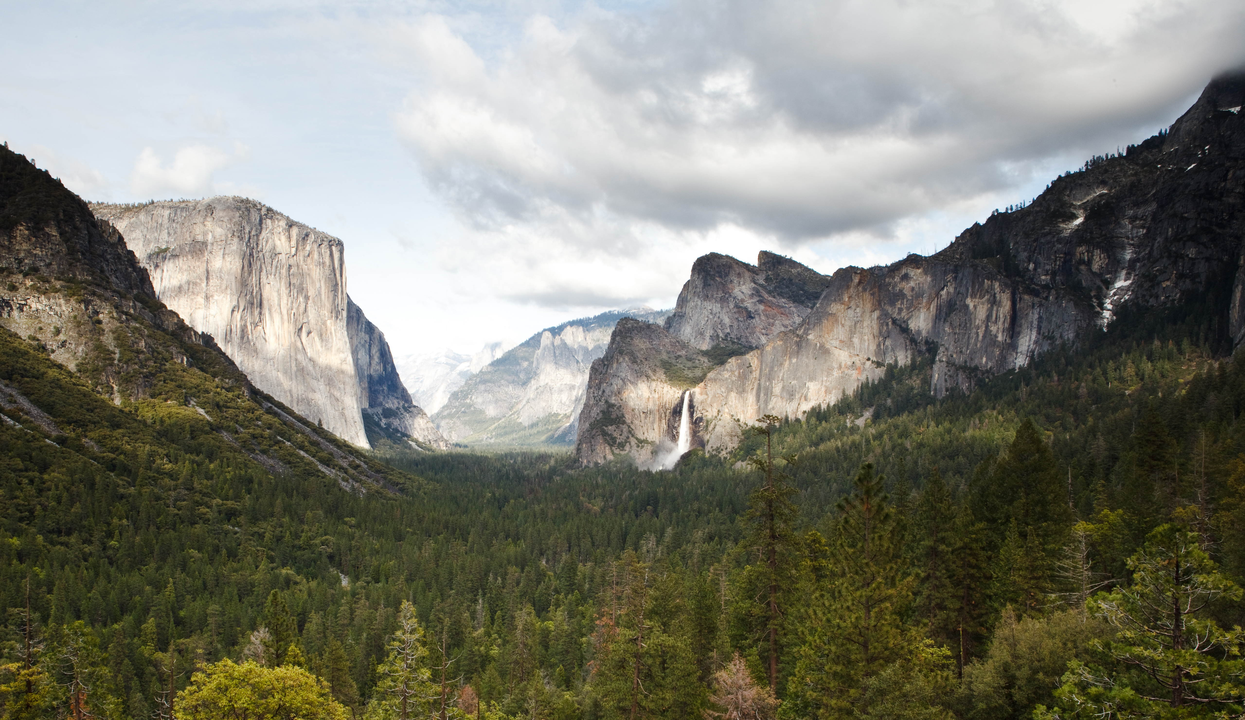

Slide 5
The Supremacy / Preemininence / No.1-ness of Christ
A view of the Lord Jesus Christ – He is above all.
Christ in relation to God
No one has ever seen God
Christ is the image of the invisible God
Christ in relation to creation
The firstborn (heir) of creation. Creation belongs to Him
He created all things (Physical and spiritual; Entire universe and heaven)
Earthly rulers (kings; presidents; prime ministers; premiers) were created by Him & for Him
Angels (even fallen angels [demons]) were created by Him and for Him
Even though creation has rebelled against Christ, He will still be glorified
Christ is glorified as Saviour; Redeemer; Suffering servant; Judge
the firstborn of all creation. ¹⁶ For by him all things were created, in heaven and on earth, visible and invisible, whether thrones or dominions or rulers or authorities — all things were created through him and for him.
Christ in relation to the church

Slide 6
The Supremacy / Preemininence / No.1-ness of Christ
A view of the Lord Jesus Christ – He is above all.
Christ in relation to God
No one has ever seen God
Christ is the image of the invisible God
Christ in relation to creation
The firstborn (heir) of creation. Creation belongs to Him
He created all things (Physical and spiritual; Entire universe and heaven)
Earthly rulers (kings; presidents; prime ministers; premiers) were created by Him & for Him
Angels (even fallen angels [demons]) were created by Him and for Him
Even though creation has rebelled against Christ, He will still be glorified
Christ is glorified as Saviour; Redeemer; Suffering servant; Judge
¹⁷ And he is before all things, and in him all things hold together.
Christ is the sustainer of creation.
Without Him, society would crumble & the universe collapse.
Christ in relation to the church

Slide 7
The Supremacy / Preemininence / No.1-ness of Christ
A view of the Lord Jesus Christ – He is above all.
Christ in relation to God
No one has ever seen God
Christ is the image of the invisible God
Christ in relation to creation
The firstborn (heir) of creation. Creation belongs to Him
He created all things (Physical and spiritual; Entire universe and heaven)
Earthly rulers (kings; presidents; prime ministers; premiers) were created by Him & for Him
Angels (even fallen angels [demons]) were created by Him and for Him
Even though creation has rebelled against Christ, He will still be glorified
Christ is glorified as Saviour; Redeemer; Suffering servant; Judge
Christ is the sustainer of creation.
Without Him, society would crumble & the universe collapse.
Christ in relation to the church
The Head of the body (the church)
The first to be raised to His permanent resurrection body
¹⁸ And he is the head of the body, the church. He is the beginning, the firstborn from the dead, that in everything he might be preeminent.

Slide 8
Isaiah 52:14 (ESV)
¹⁴ As many were astonished at you—
his appearance was so marred, beyond human semblance,
and his form beyond that of the children of mankind—

Slide 9
The Supremacy / Preemininence / No.1-ness of Christ
A view of the Lord Jesus Christ – He is above all.
Christ in relation to God
No one has ever seen God
Christ is the image of the invisible God
Christ in relation to creation
The firstborn (heir) of creation. Creation belongs to Him
He created all things (Physical and spiritual; Entire universe and heaven)
Earthly rulers (kings; presidents; prime ministers; premiers) were created by Him & for Him
Angels (even fallen angels [demons]) were created by Him and for Him
Even though creation has rebelled against Christ, He will still be glorified
Christ is glorified as Saviour; Redeemer; Suffering servant; Judge
Christ is the sustainer of creation.
Without Him, society would crumble & the universe collapse.
Christ in relation to the church
The Head of the body (the church)
The first to be raised to His permanent resurrection body
¹⁹ For in him all the fullness of God was pleased to dwell, ²⁰ and through him to reconcile to himself all things, whether on earth or in heaven, making peace by the blood of his cross.
Christ is the fullness of God. It was God’s pleasure to suffer to save us from our sins
Only one true God. None other can stand beside. Christ is above all.

